Slide 1
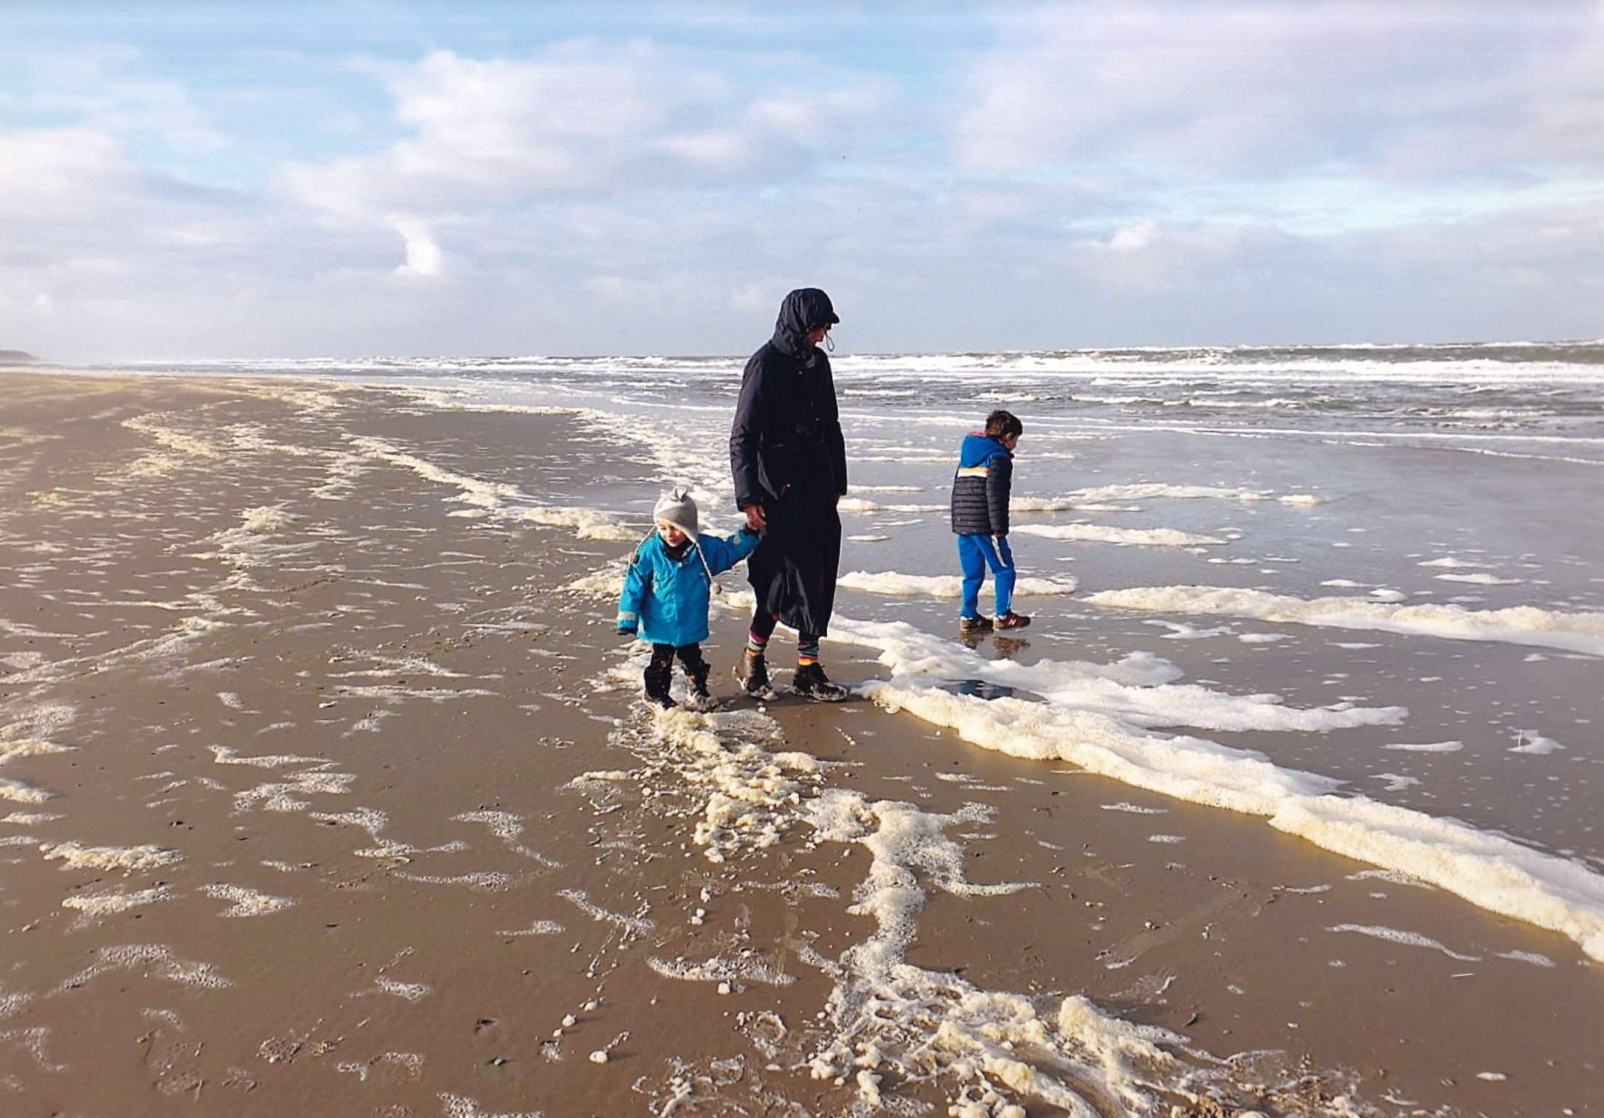
JANUARY 2020

Slide 2


Slide 3
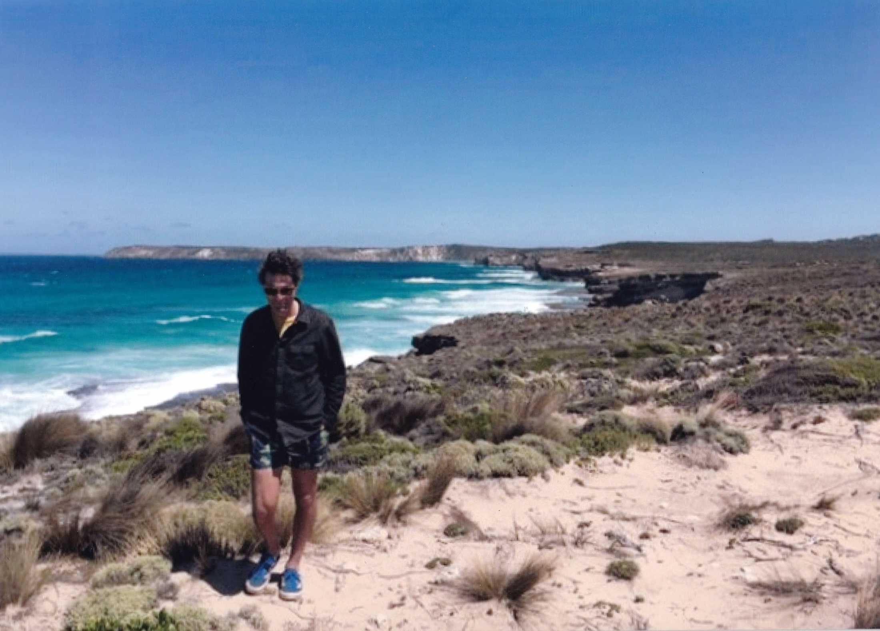
MARCH
Kangaroo Island, Sth. Coast

Slide 4
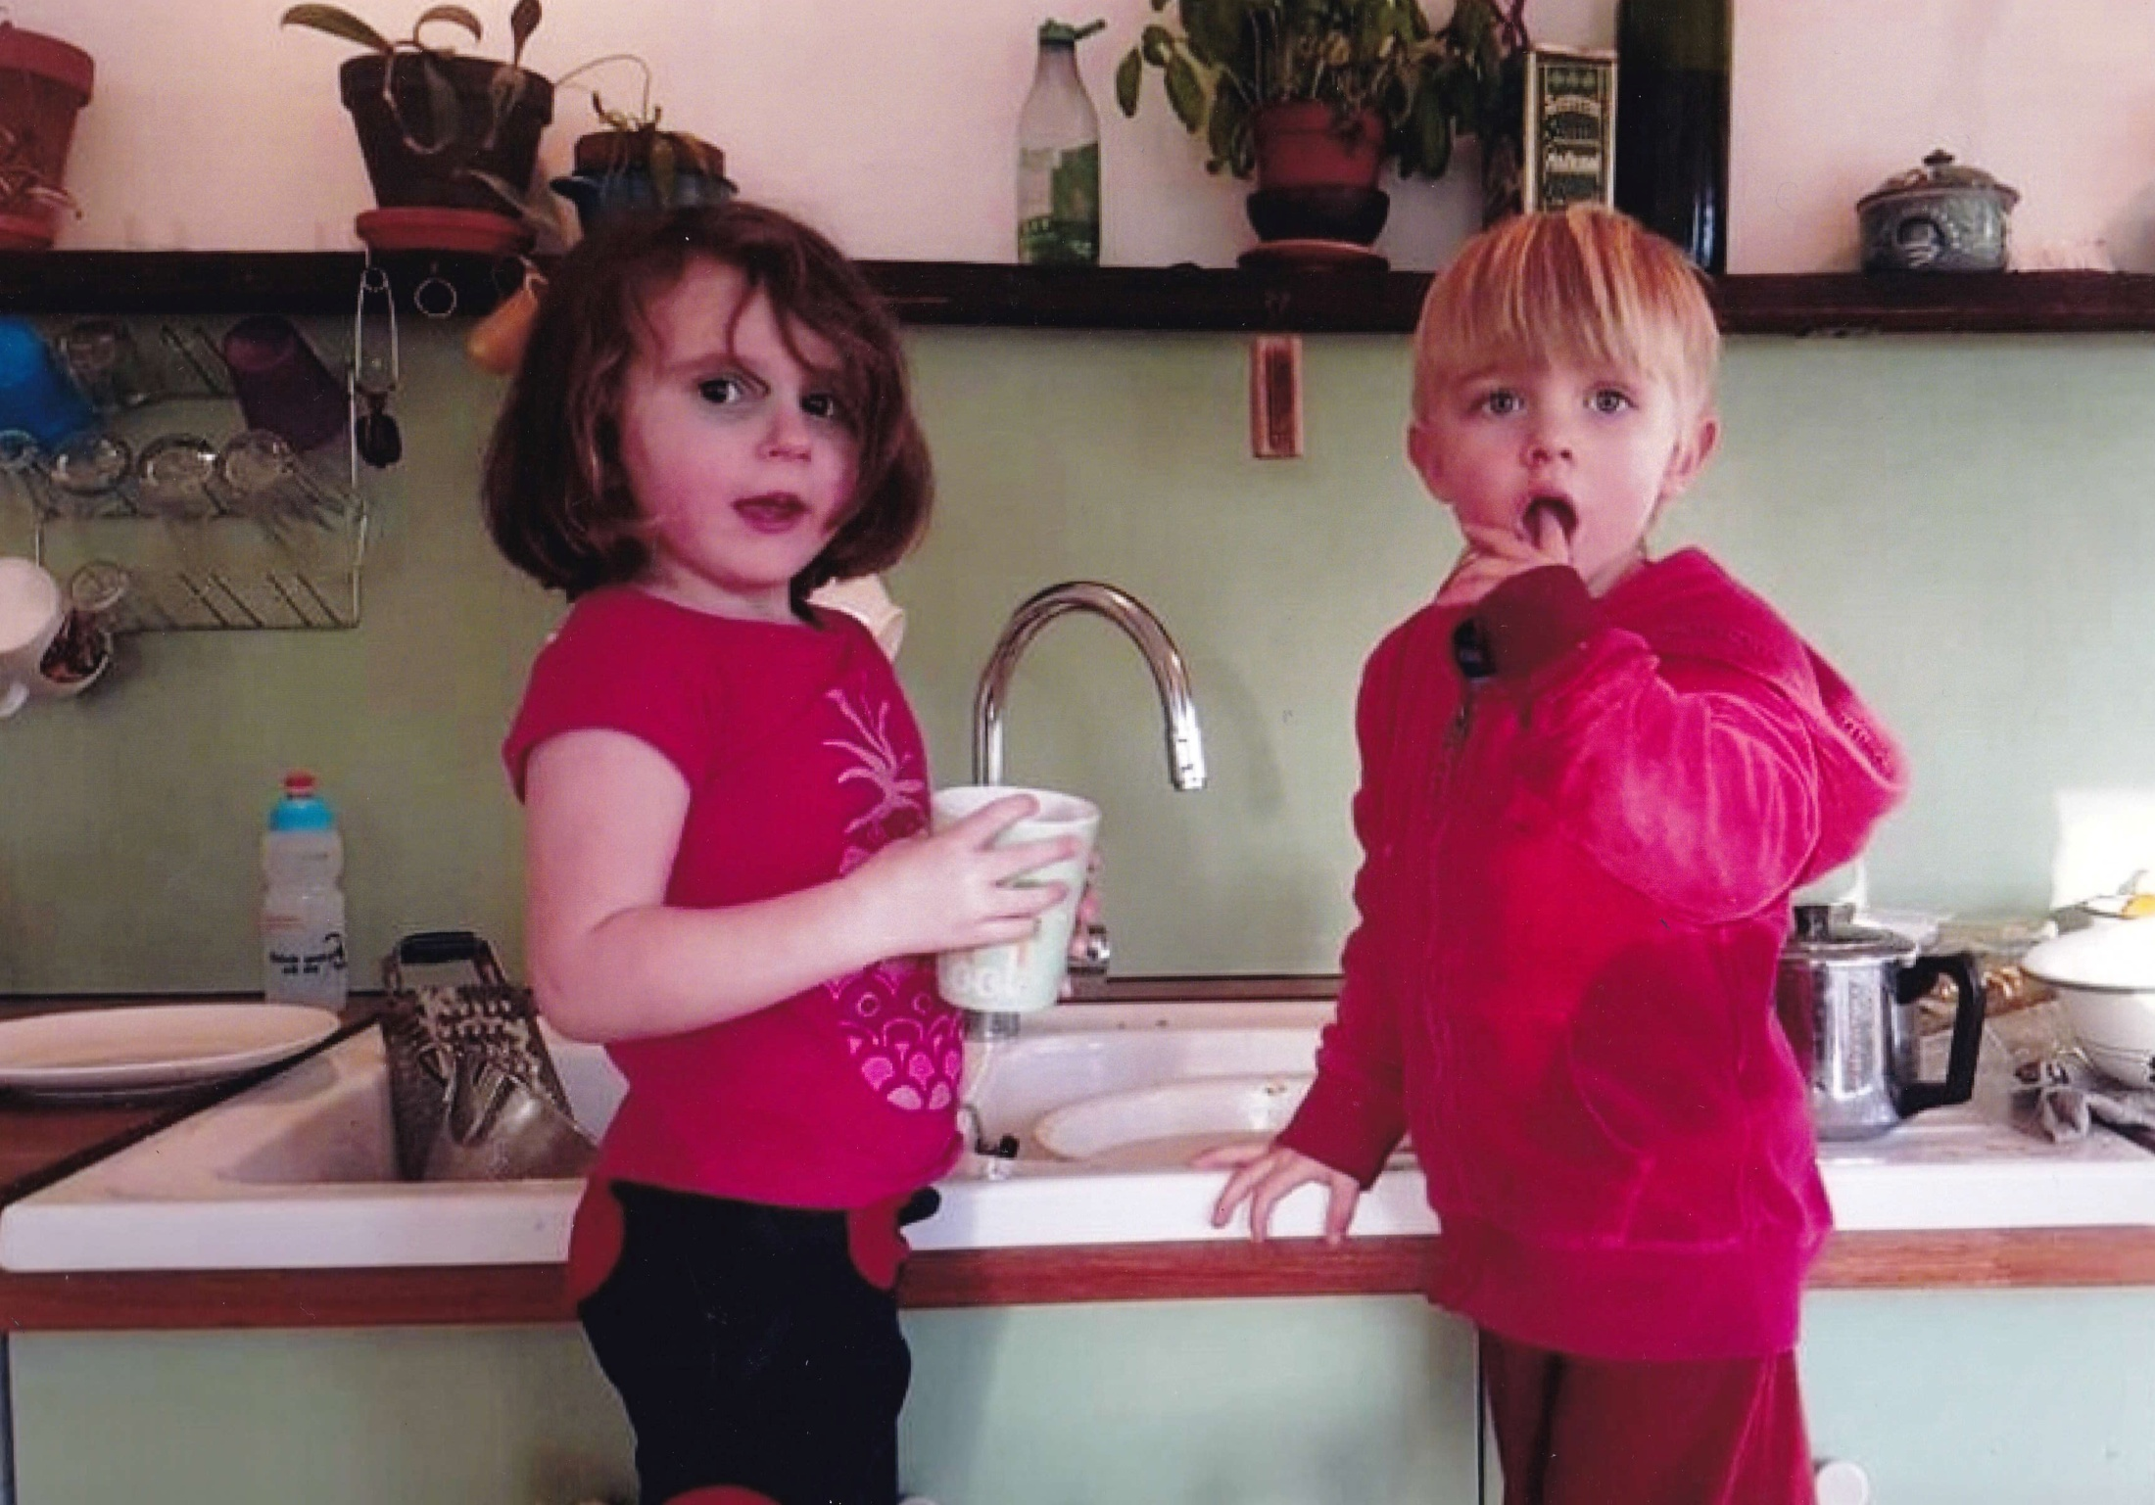
APRIL
Phoenix
Salvador

Slide 5

MAY
Laszlo
Notes:
5

Slide 6
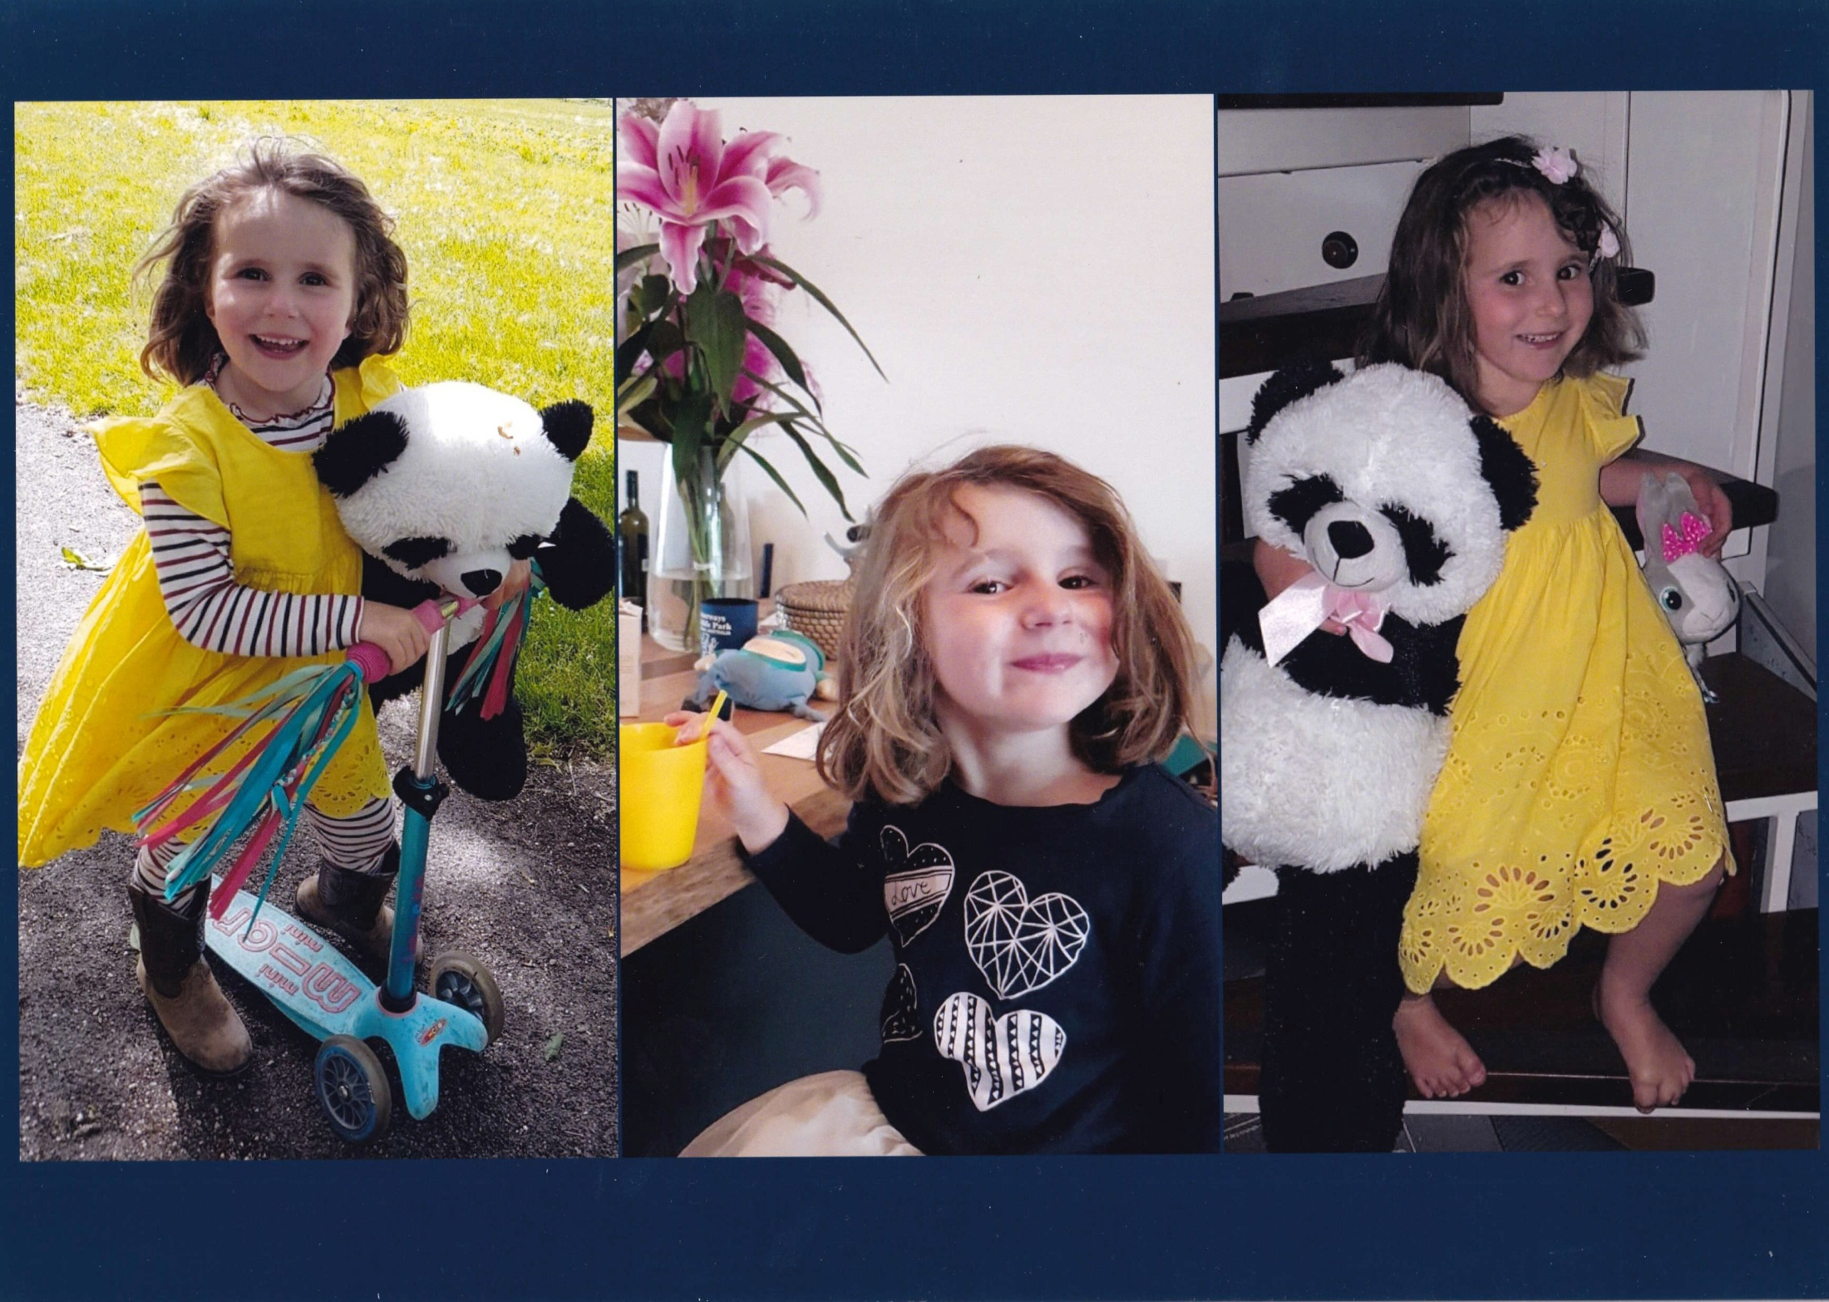
JUNE

Slide 7
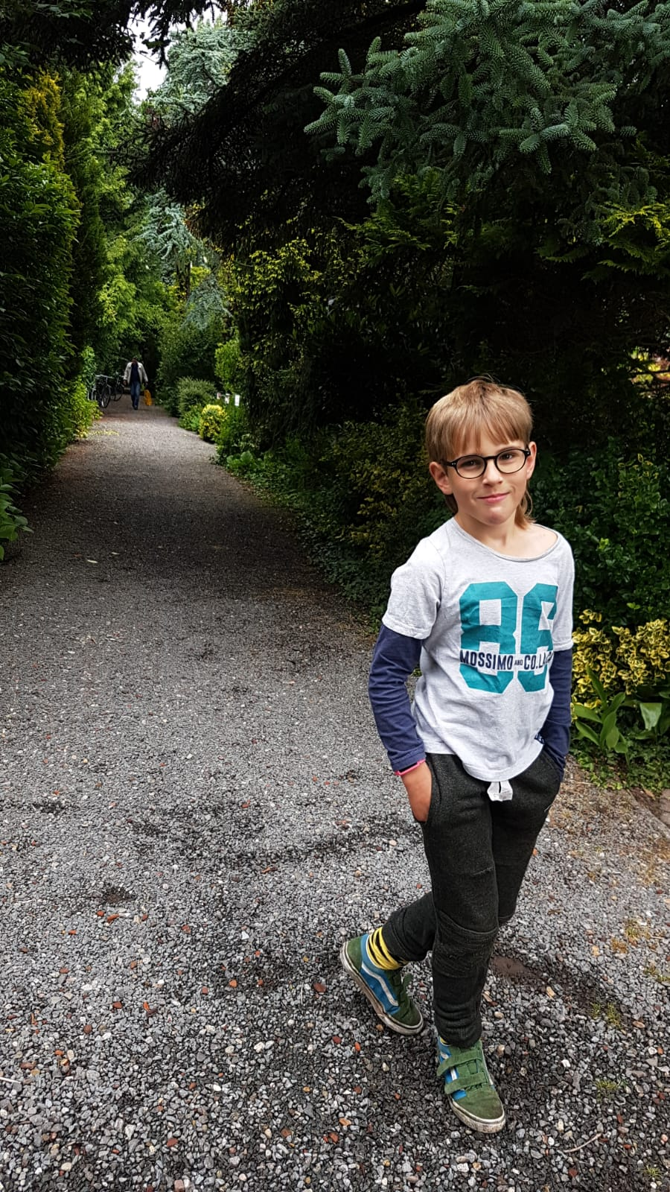
JULY
Xanadu
Notes:
7

Slide 8
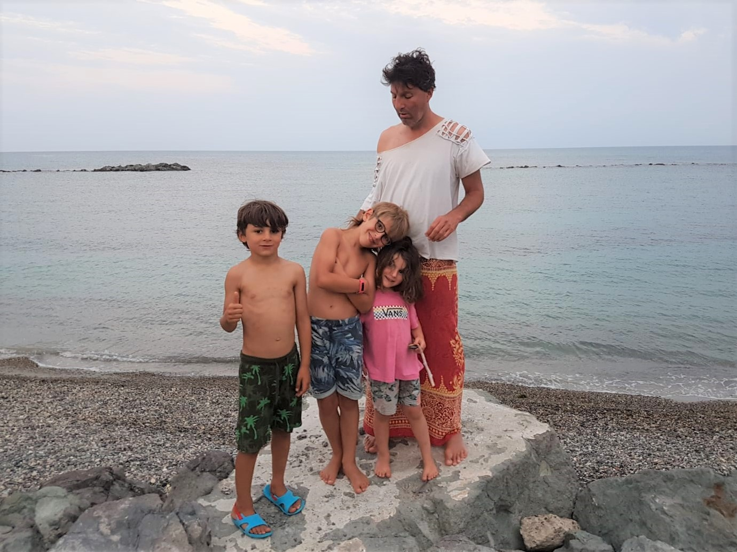
AUGUST
Laszlo Xanadu Phoenix Jacob
Sardinia
Notes:
8

Slide 9
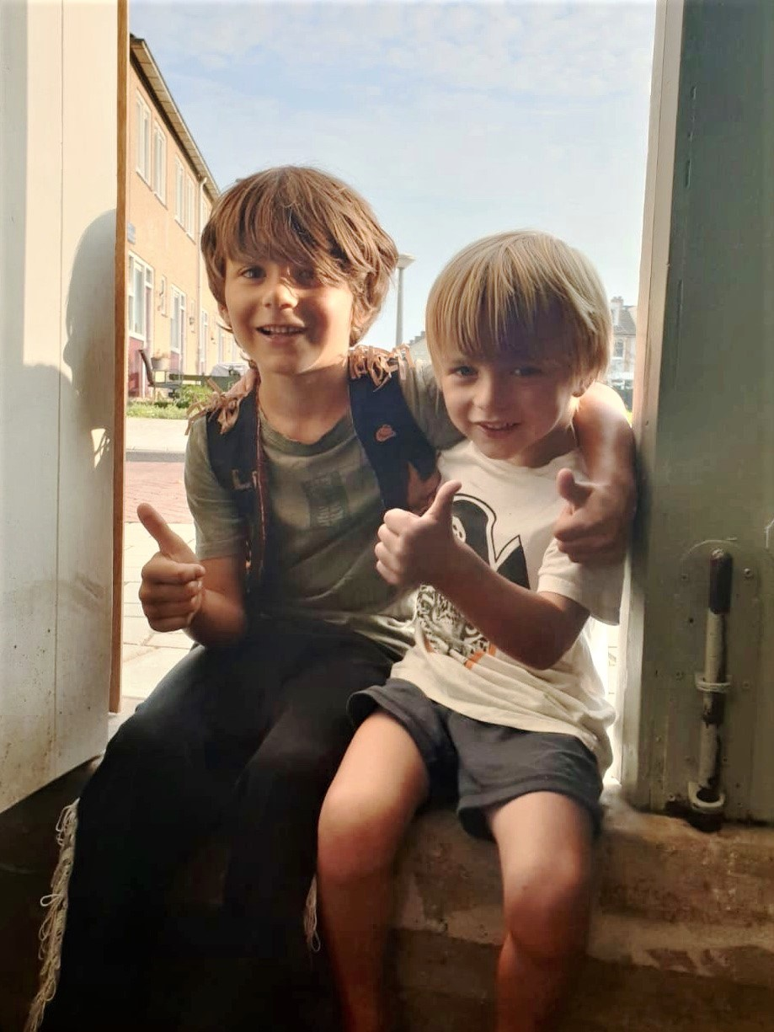
SEPTEMBER

Slide 10
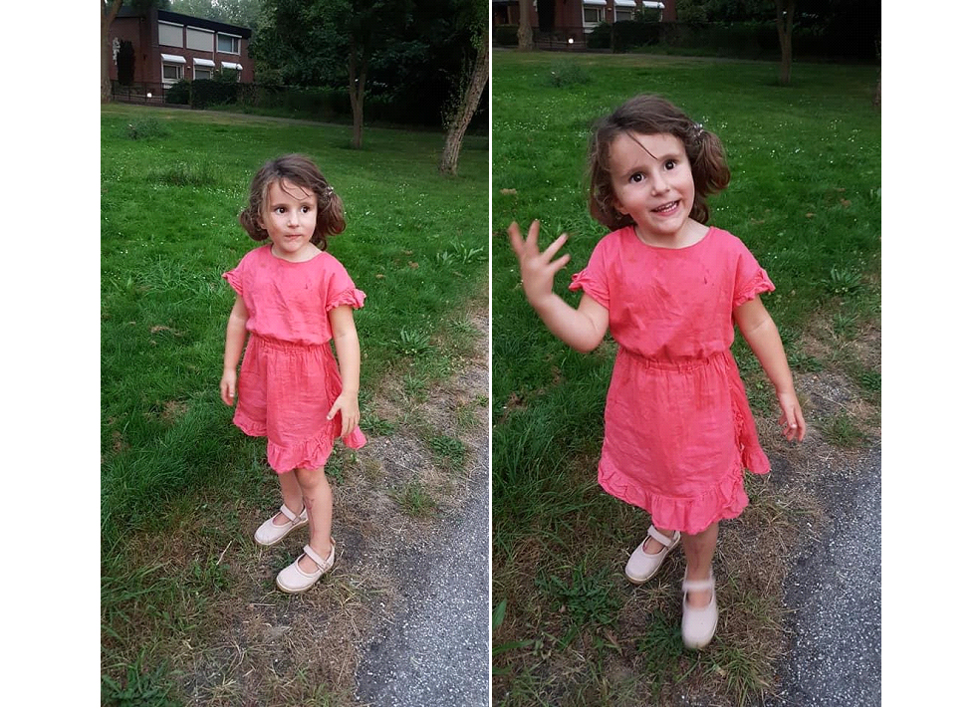
OCTOBER

Slide 11
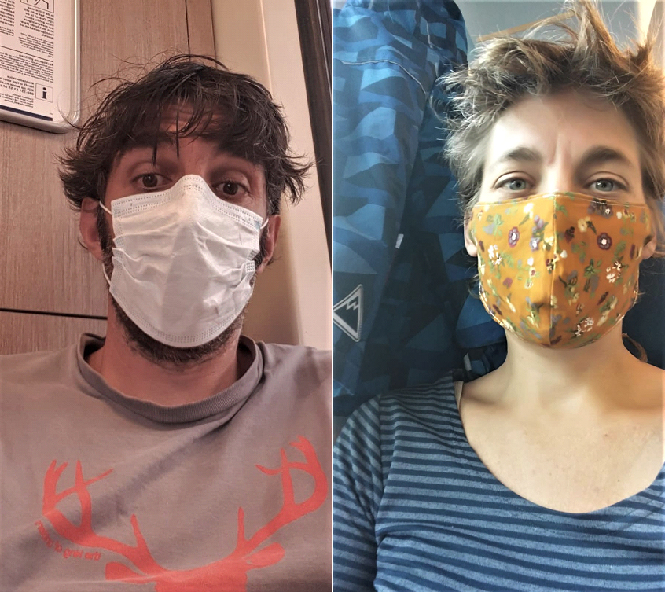
NOVEMBER
Jim
Jetske

Slide 12
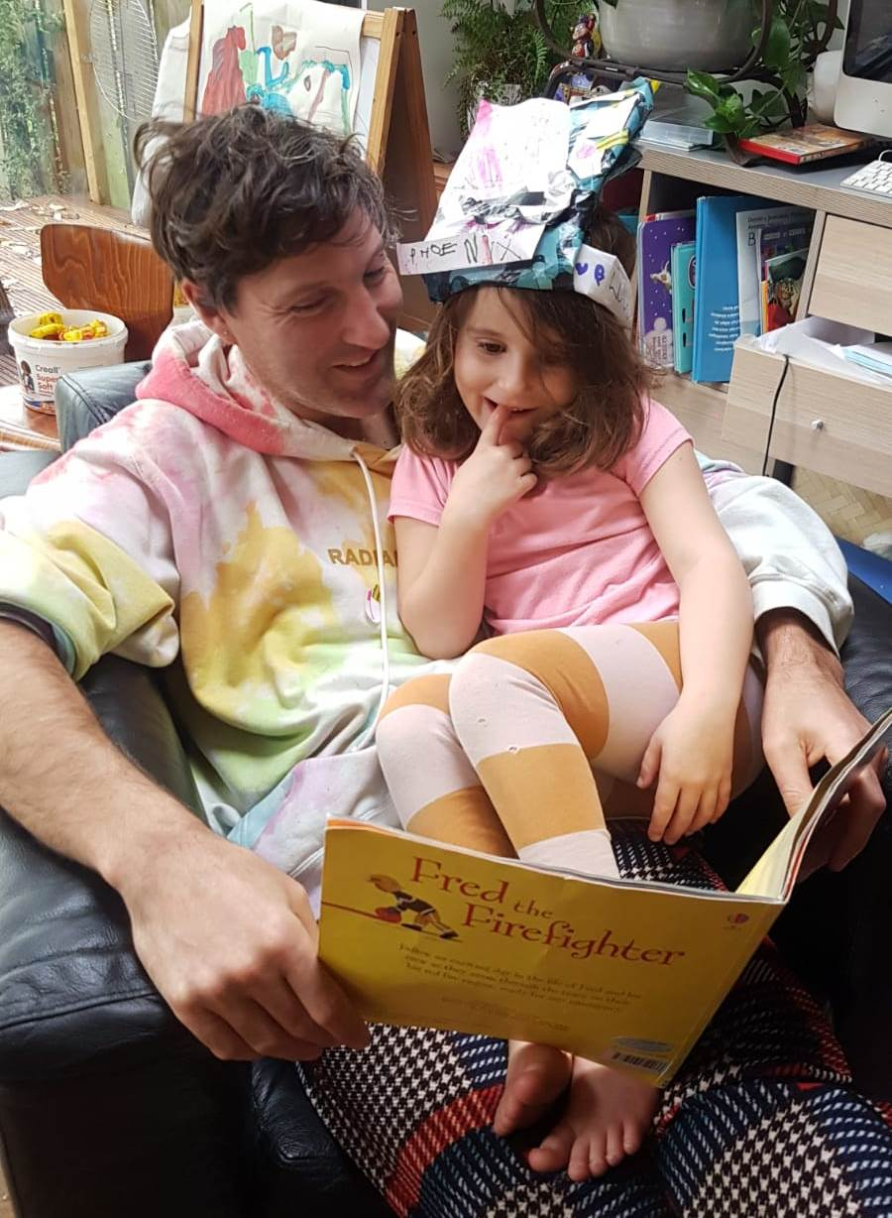
DECEMBER
Notes:
12

