Slide 1

JANUARY

Slide 2
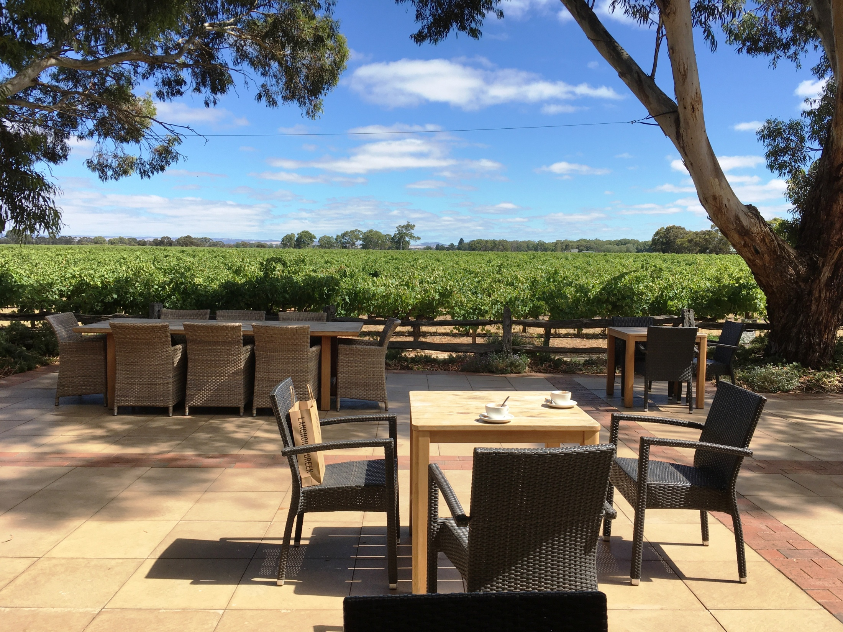
Lake Breeze Winery
Langhorne Creek
FEBRUARY

Slide 3

MARCH

Slide 4

APRIL

Slide 5

MAY

Slide 6

JUNE

Slide 7

JULY

Slide 8

AUGUST

Slide 9
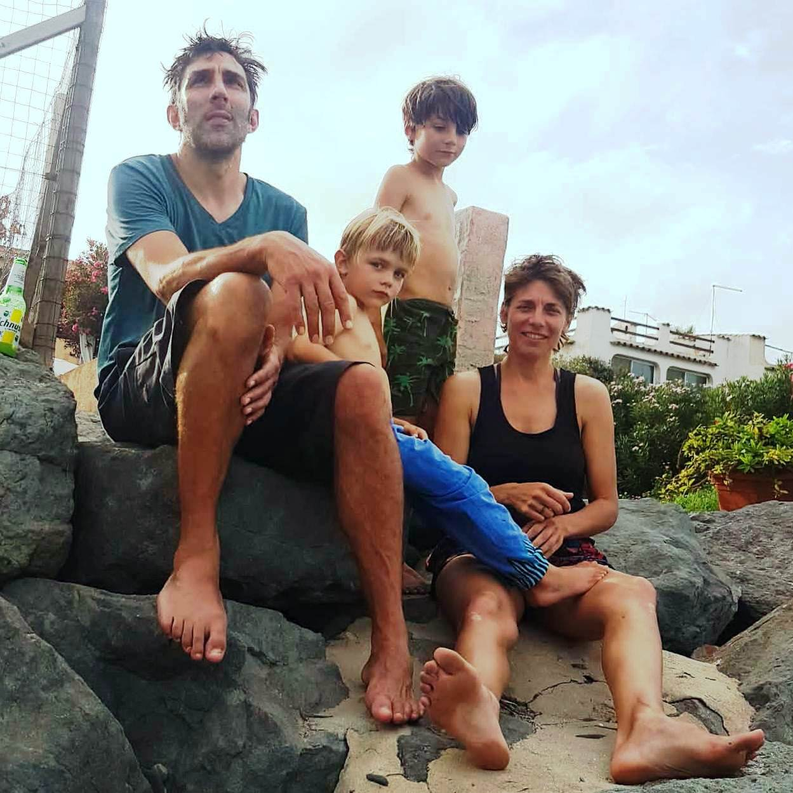
SEPTEMBER

Slide 10

OCTOBER

Slide 11

NOVEMBER

Slide 12

DECEMBER

