Slide 1

January 2024

Slide 2

February

Slide 3
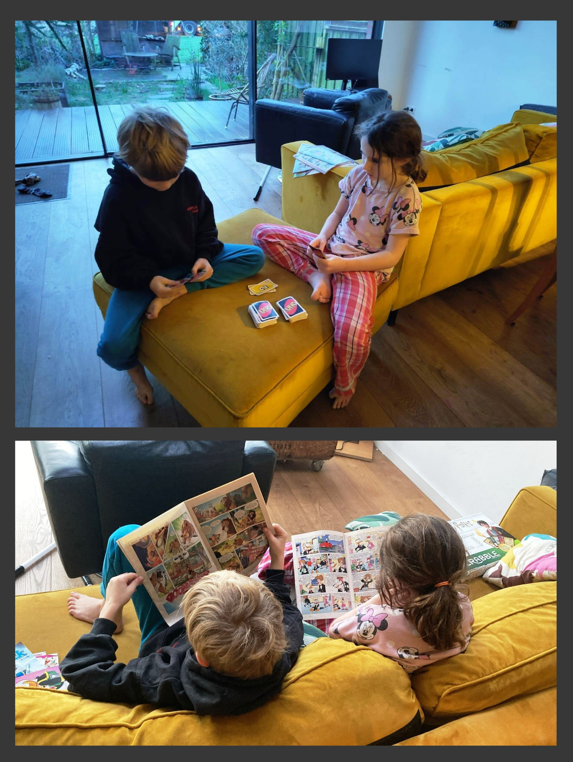
March

Slide 4
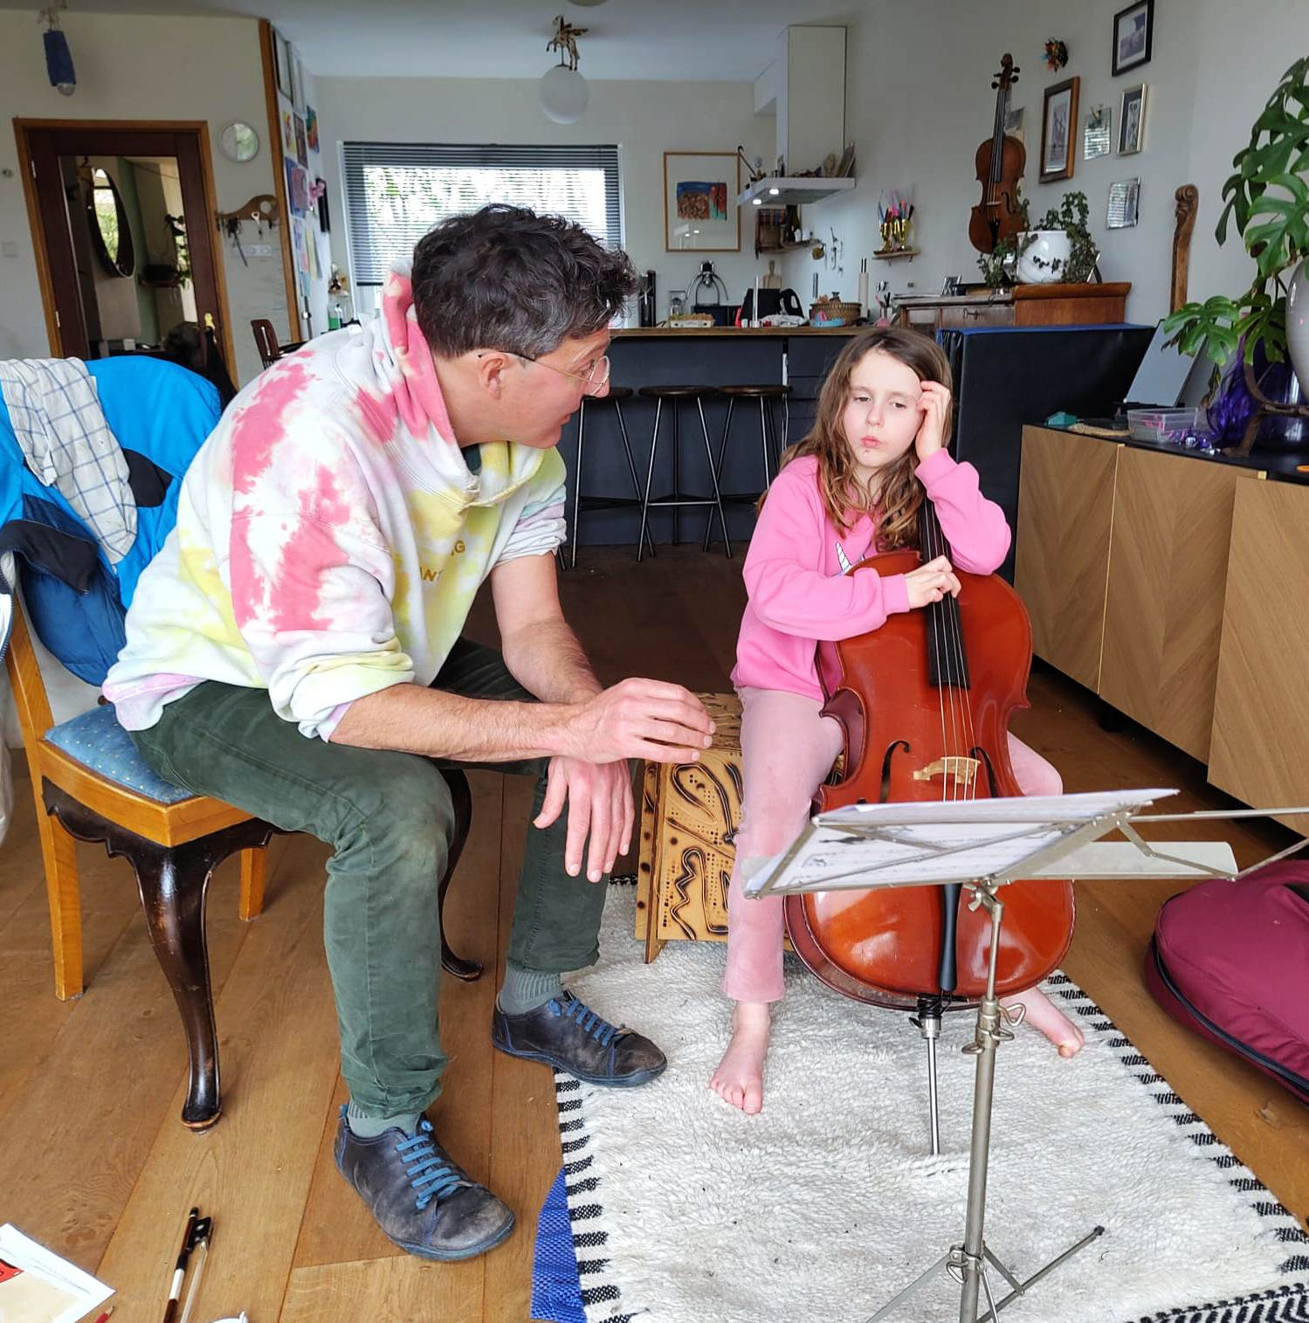
April

Slide 5

May

Slide 6
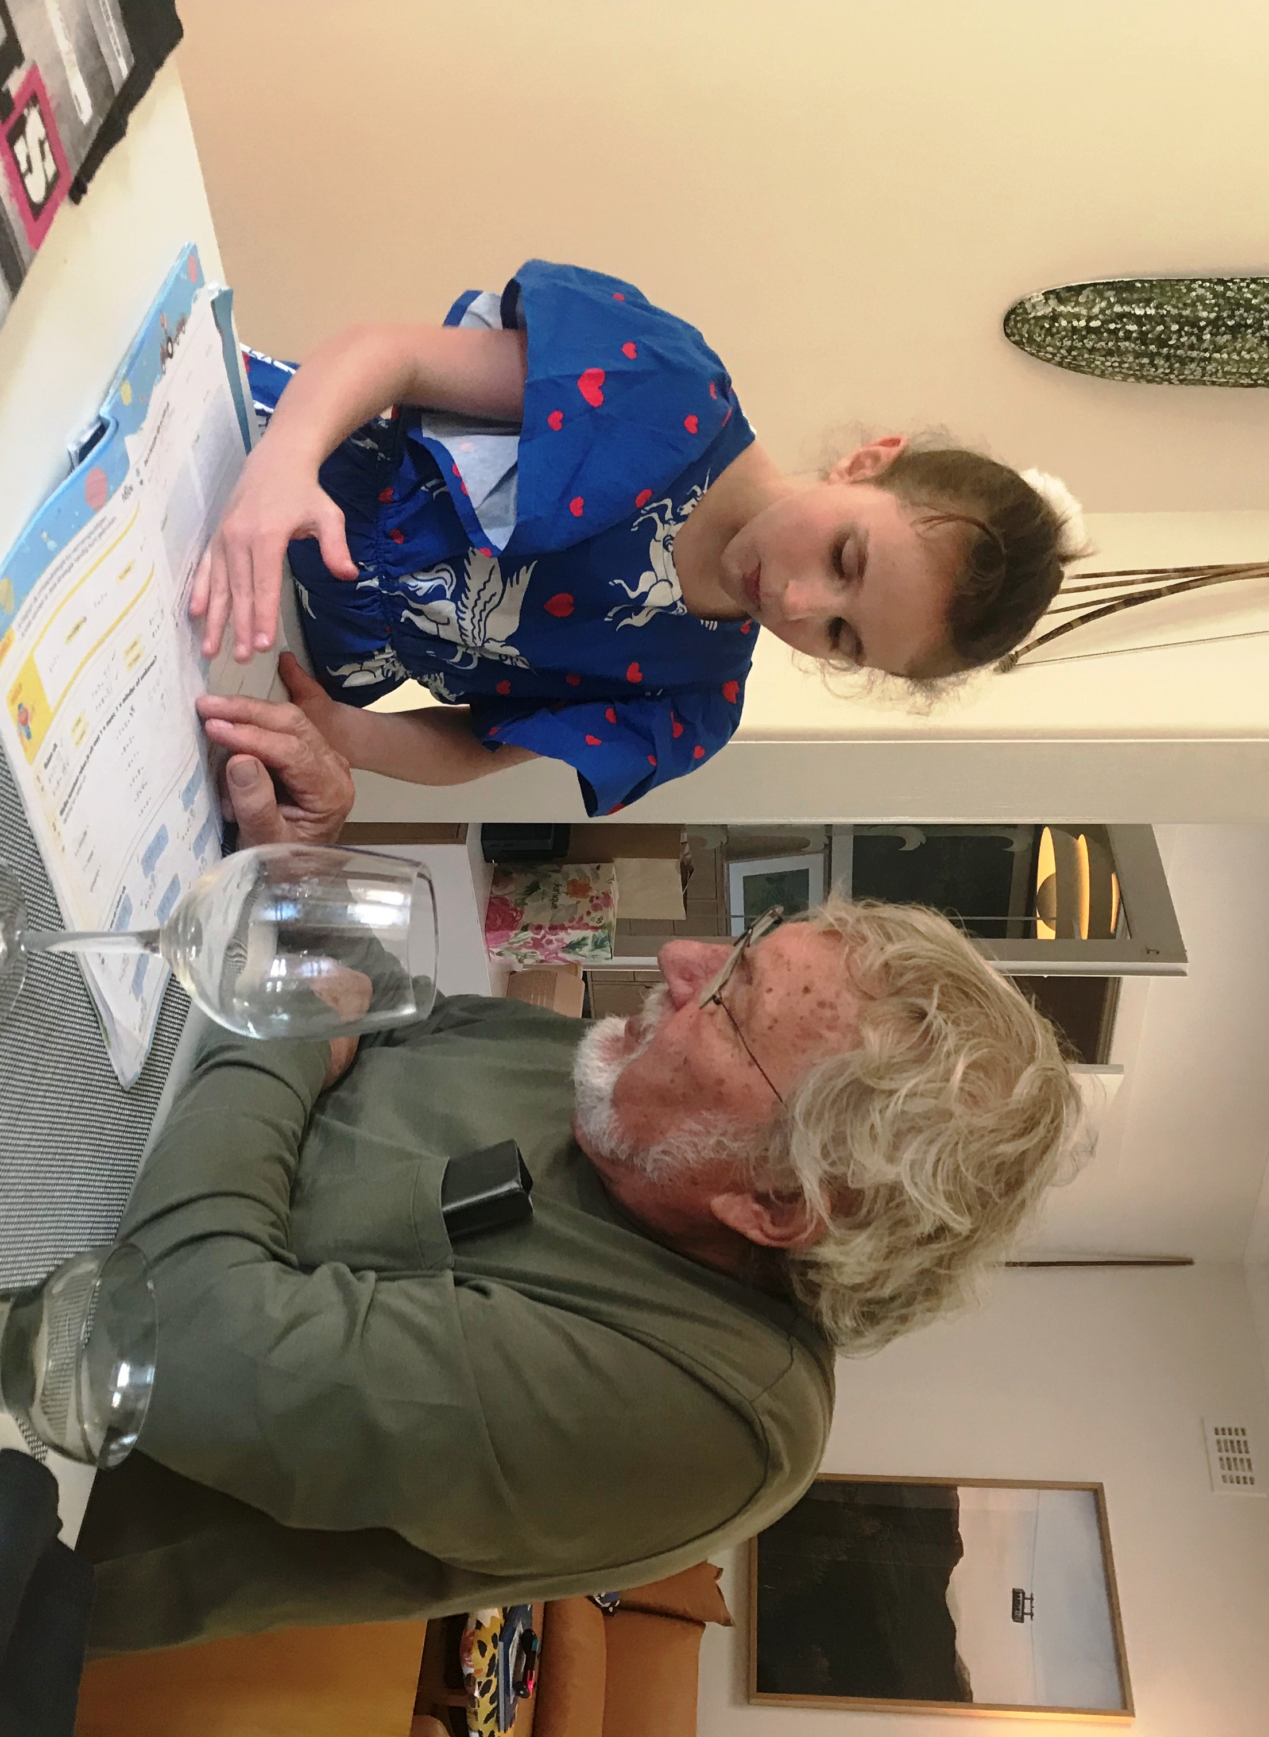
June

Slide 7
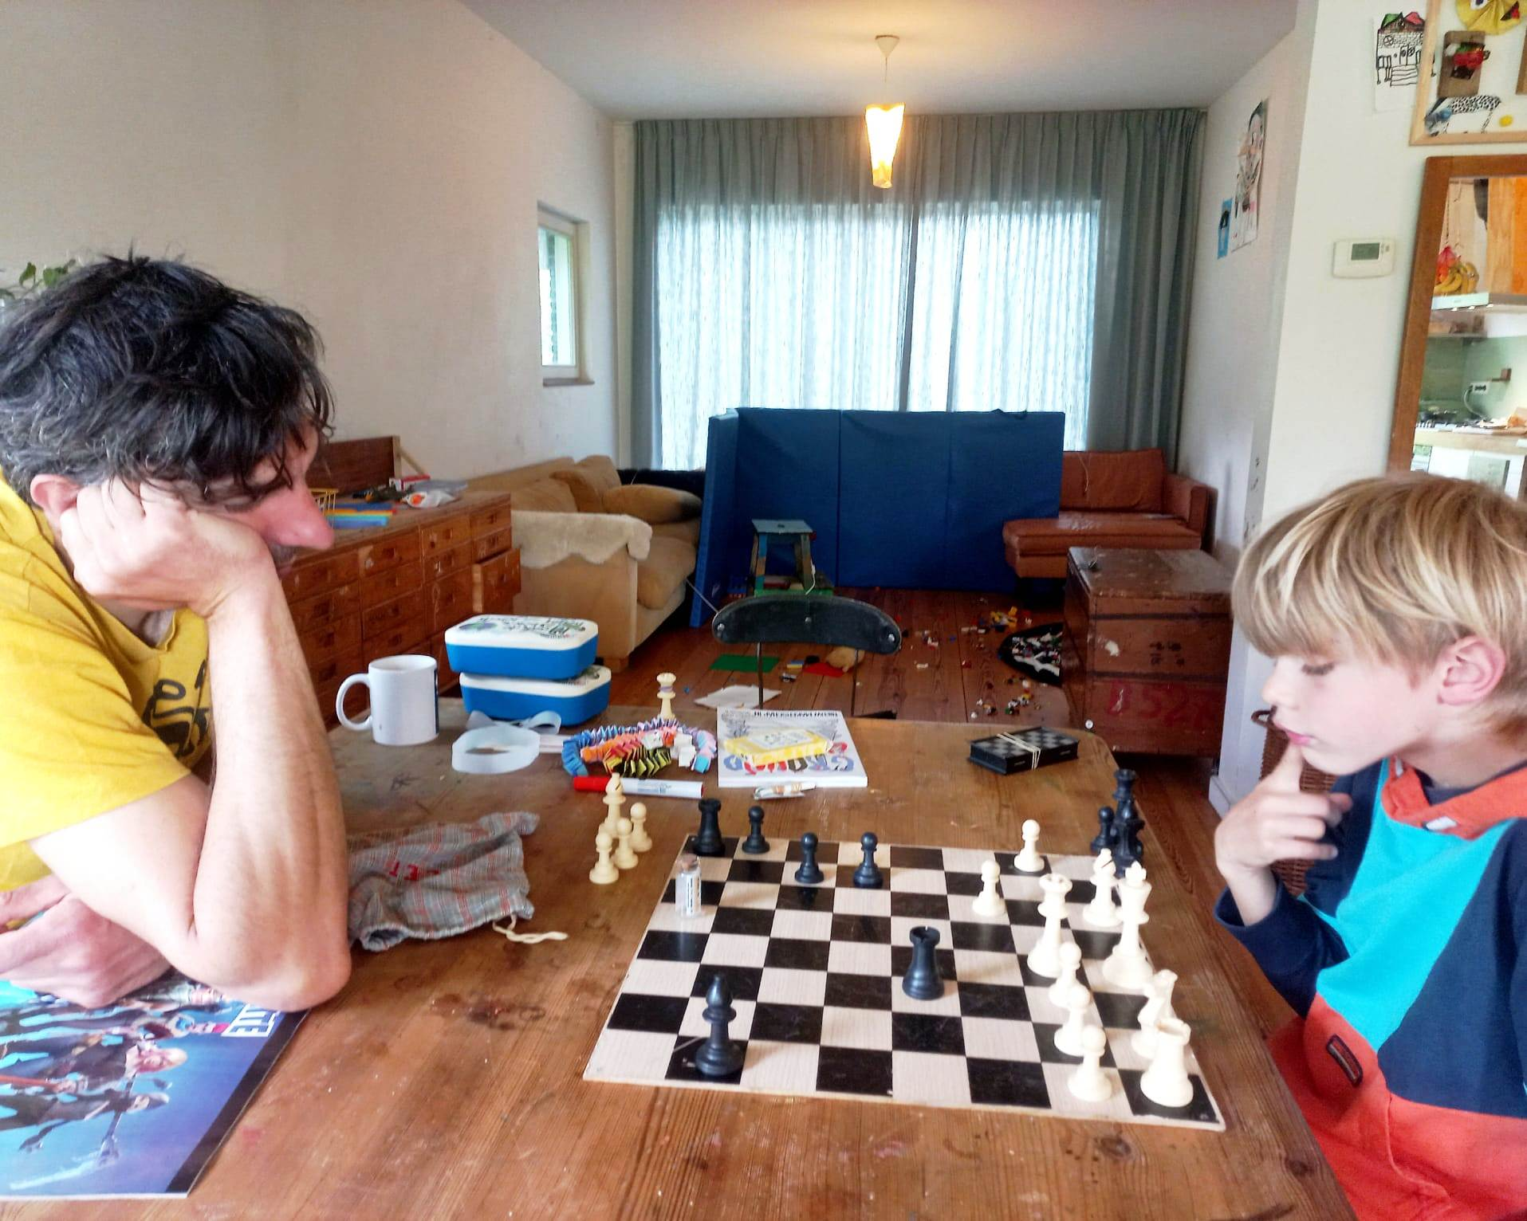
July

Slide 8

August

Slide 9
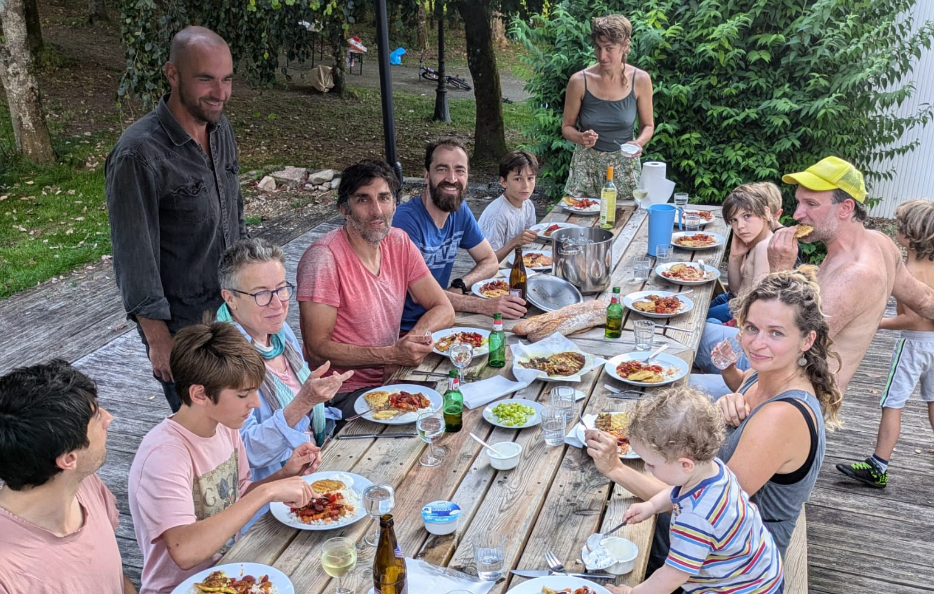
September

Slide 10

October

Slide 11

November

Slide 12

December

