Slide 1
2025 Calendar Photo Album
by Dan and Katina Plooij

Slide 2
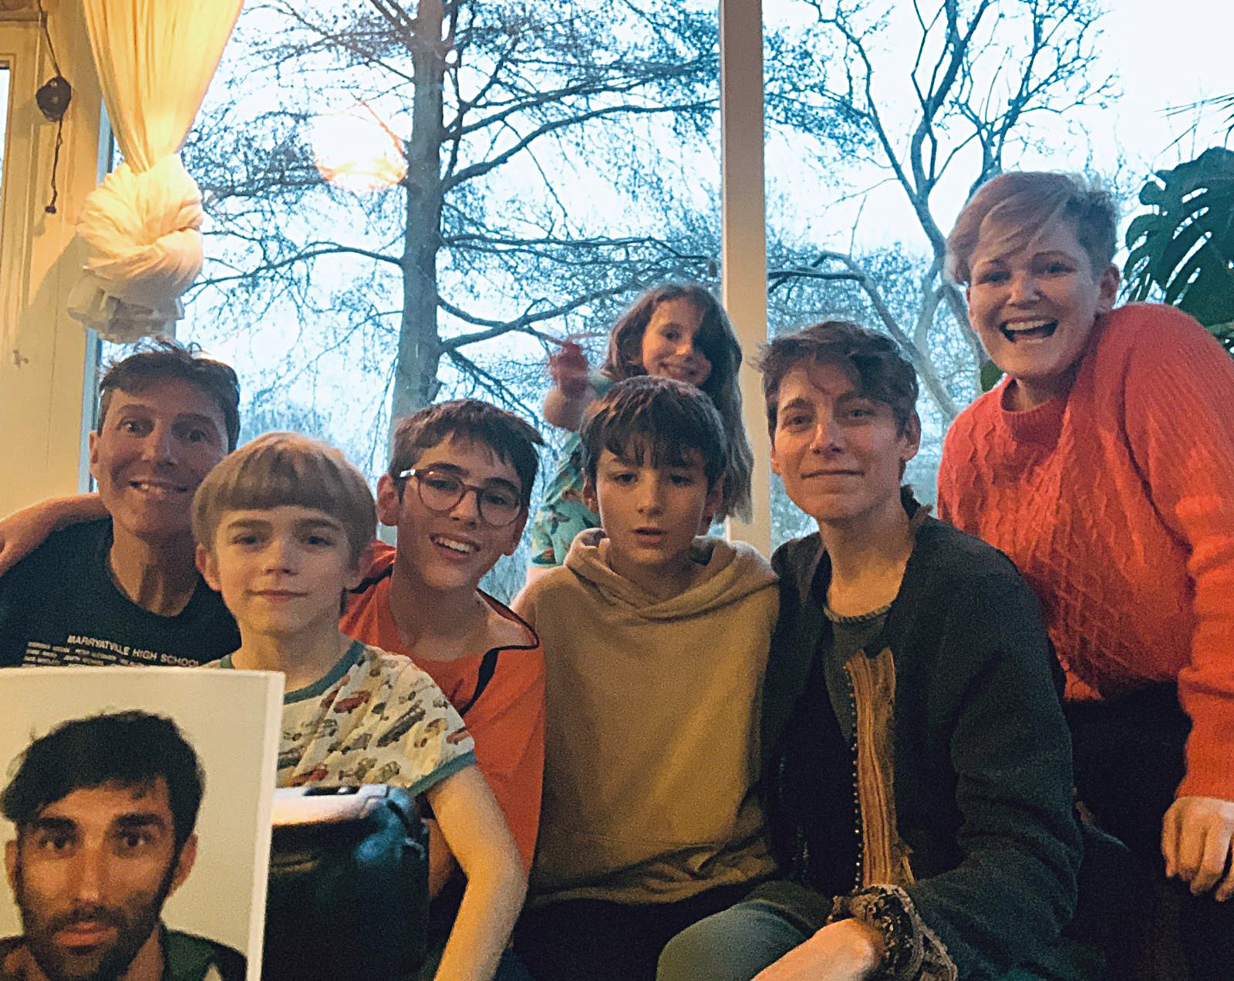
January
Jacob
Sali
Xanadu
Phoenix
Jetske
Jim
Laszlo
Jennette

Slide 3
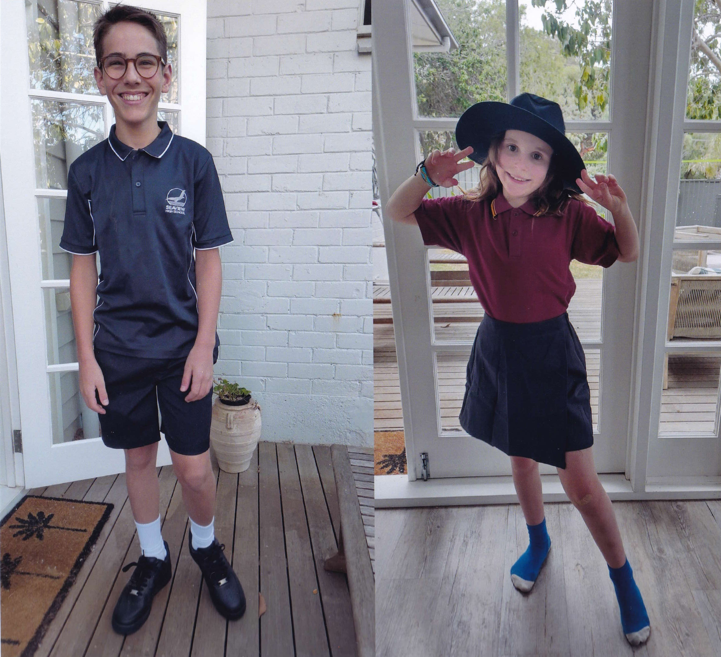
February

Slide 4
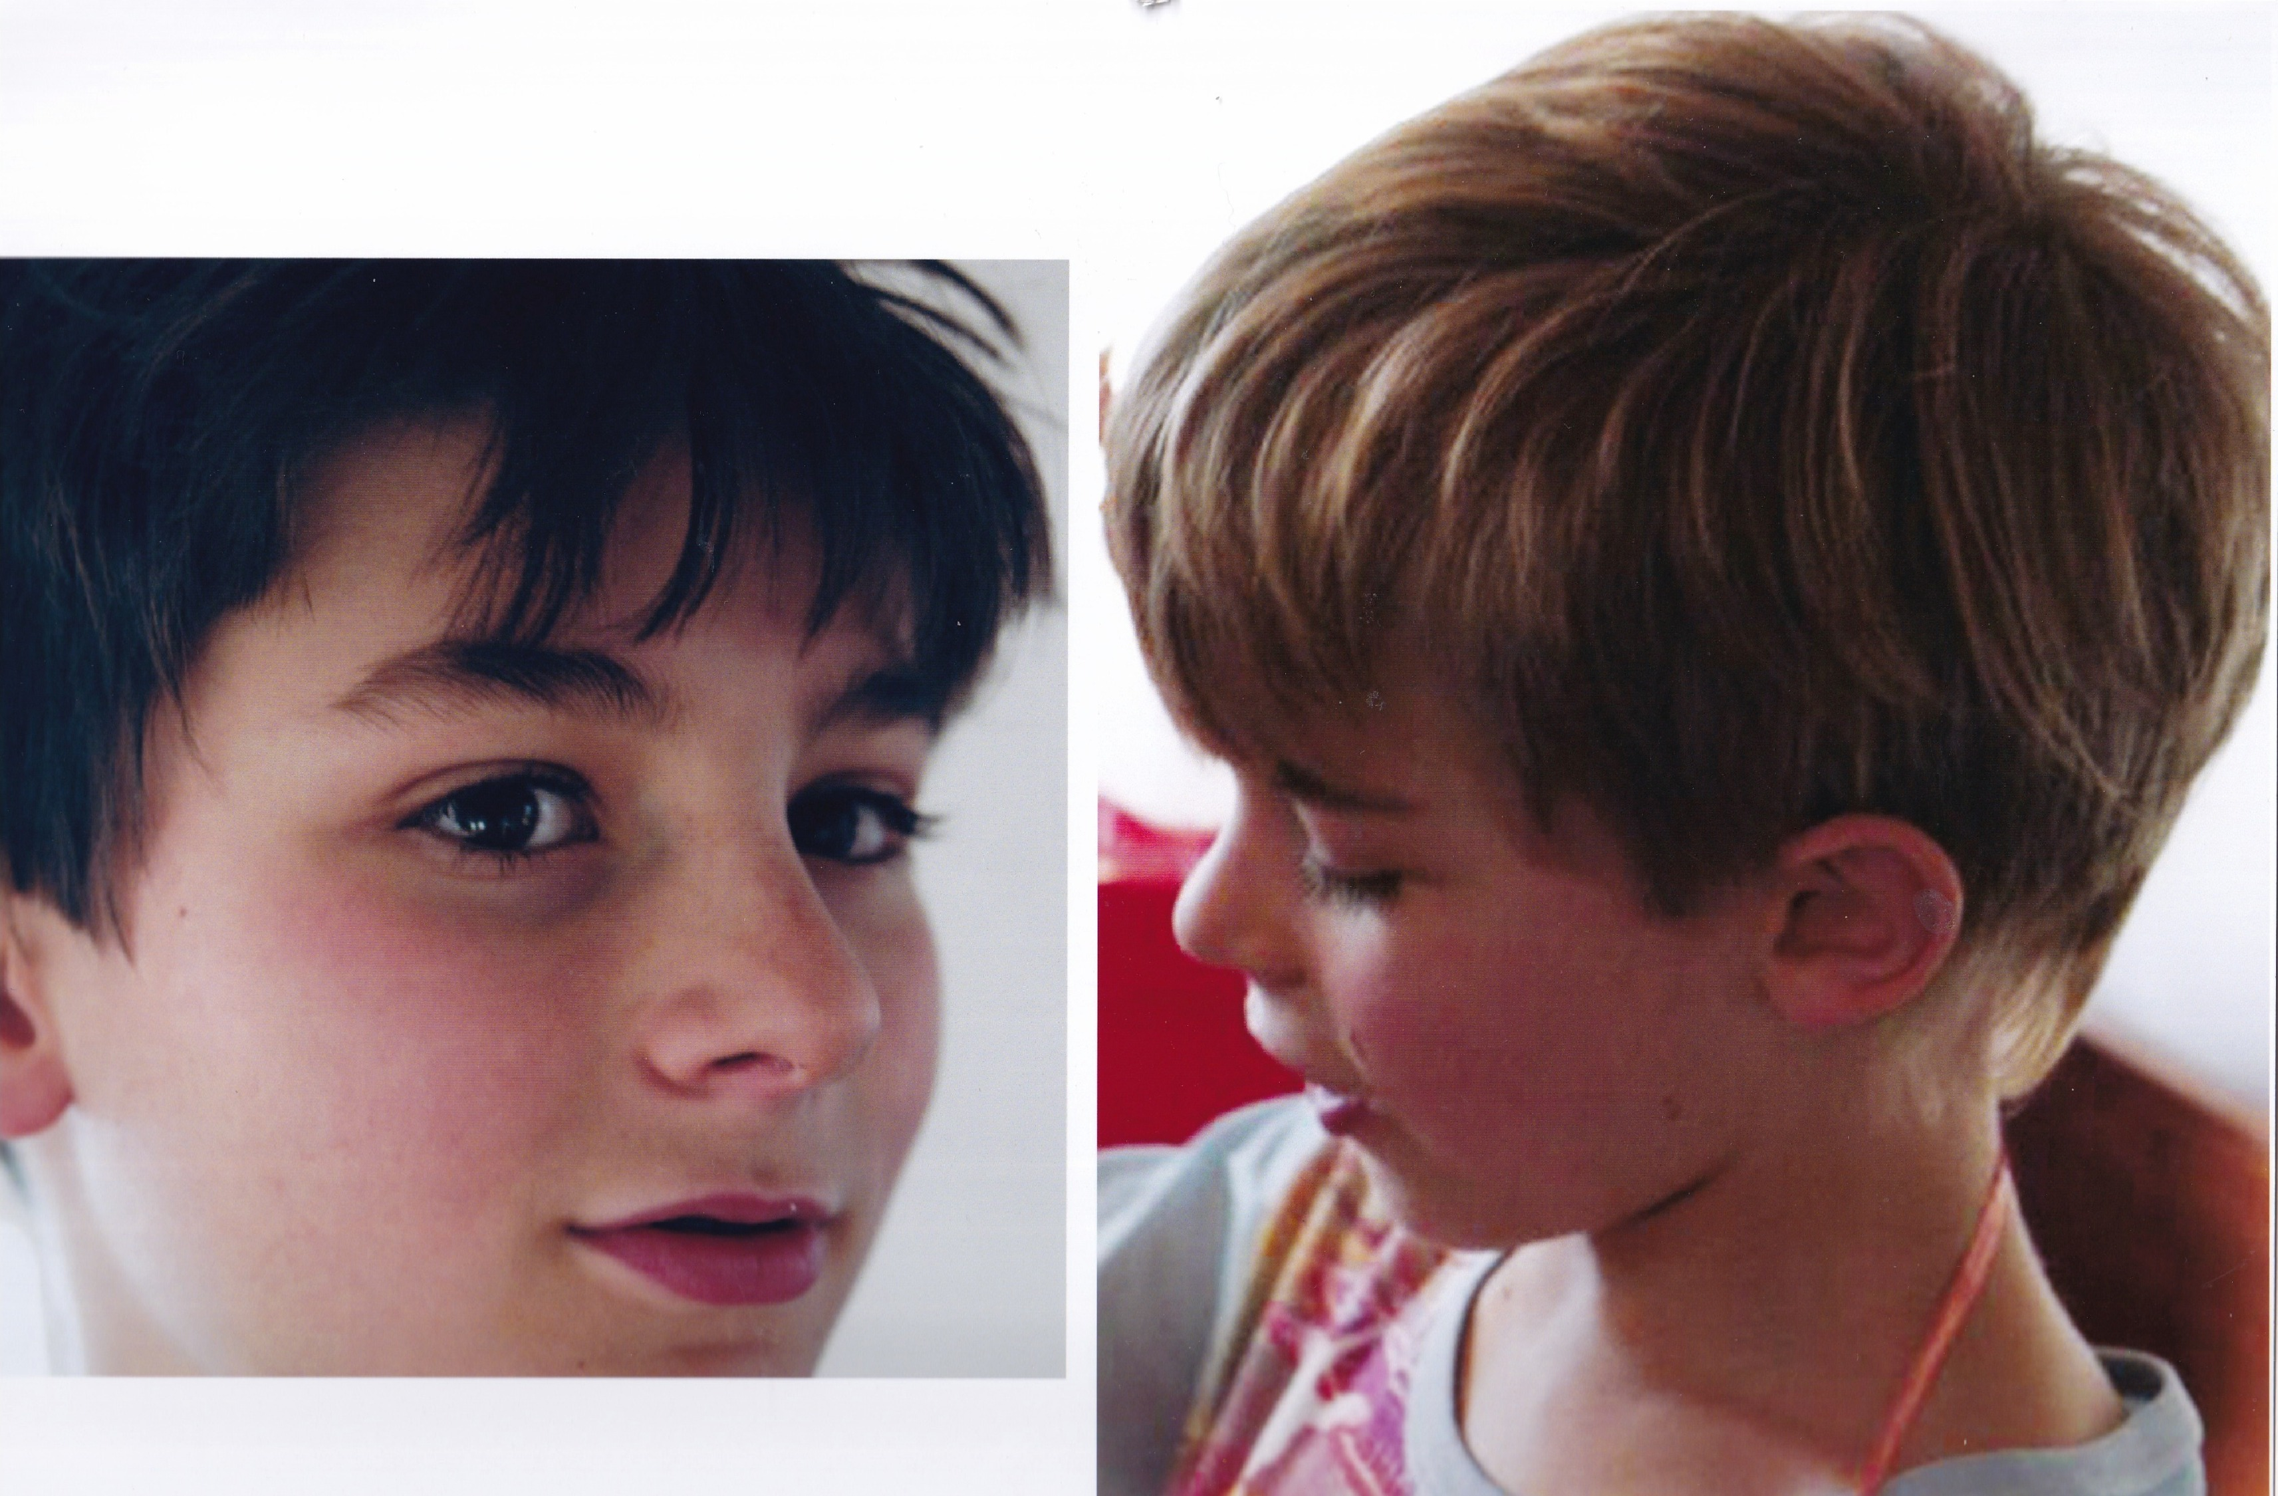
March

Slide 5
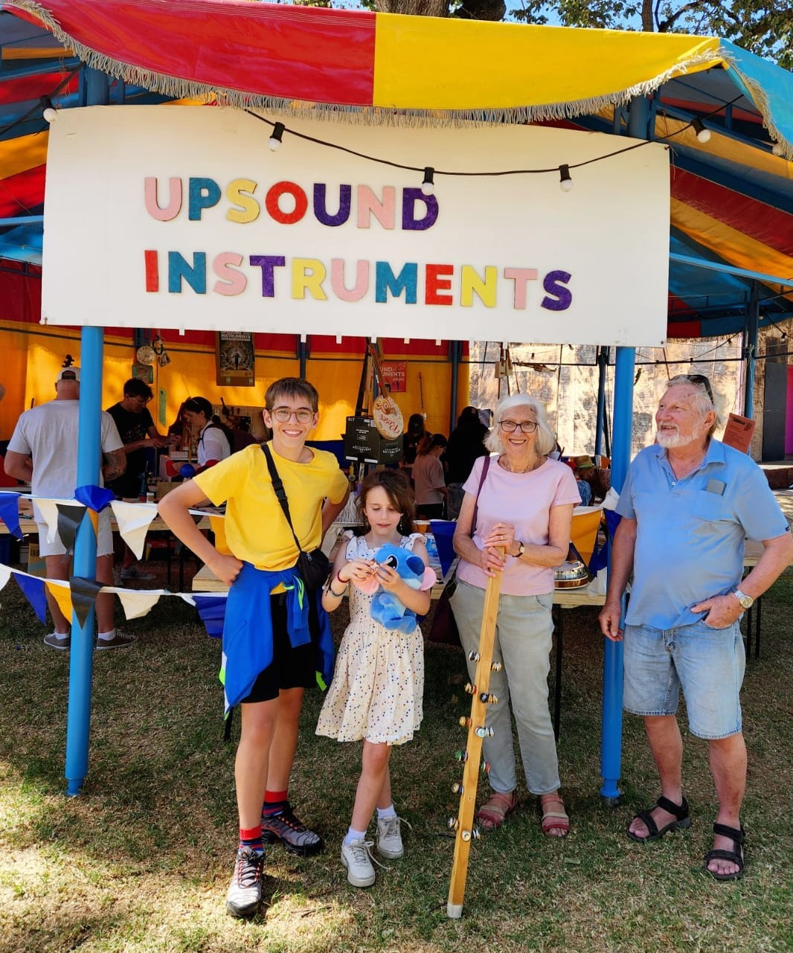
April
Notes:
Jacob’s Tent at the Adelaide Fringe Festival’s Garden of Un-earthly Delights

Slide 6
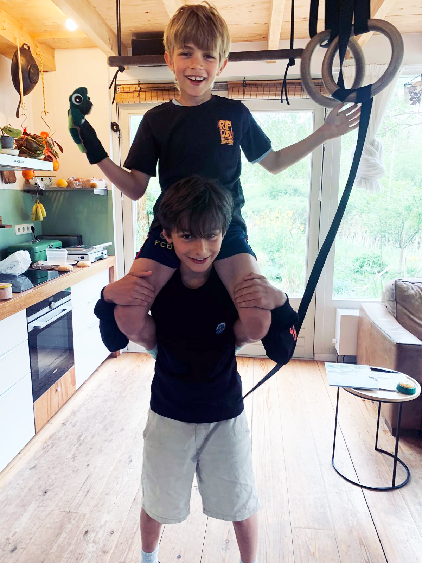
May

Slide 7
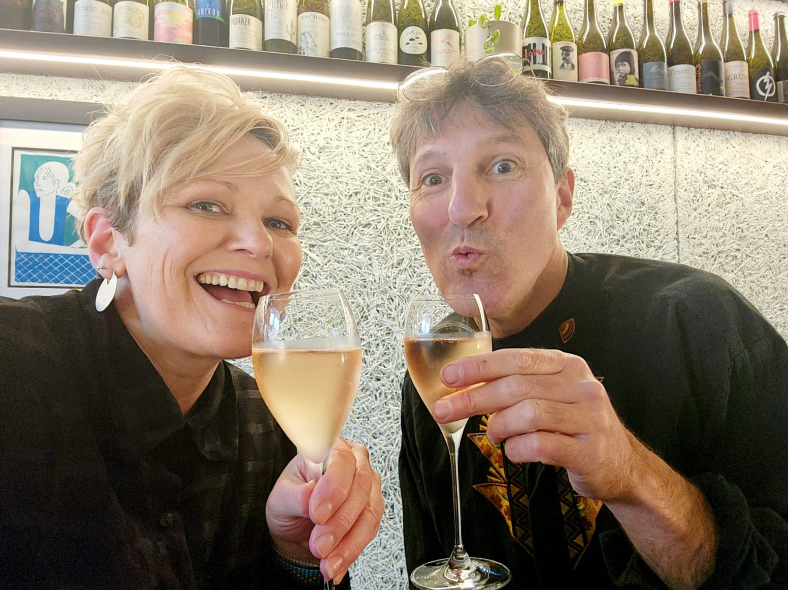
June

Slide 8
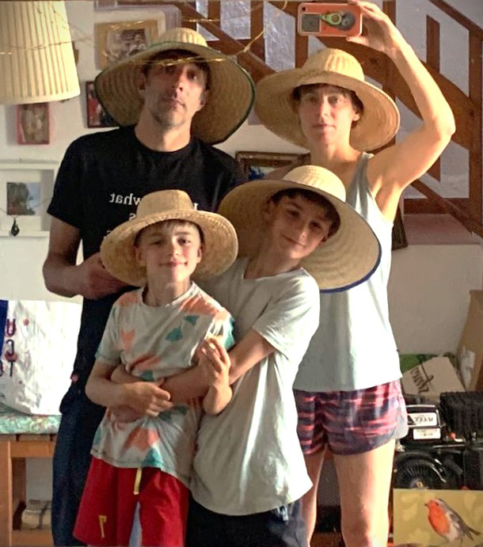
July
Inscape

Slide 9
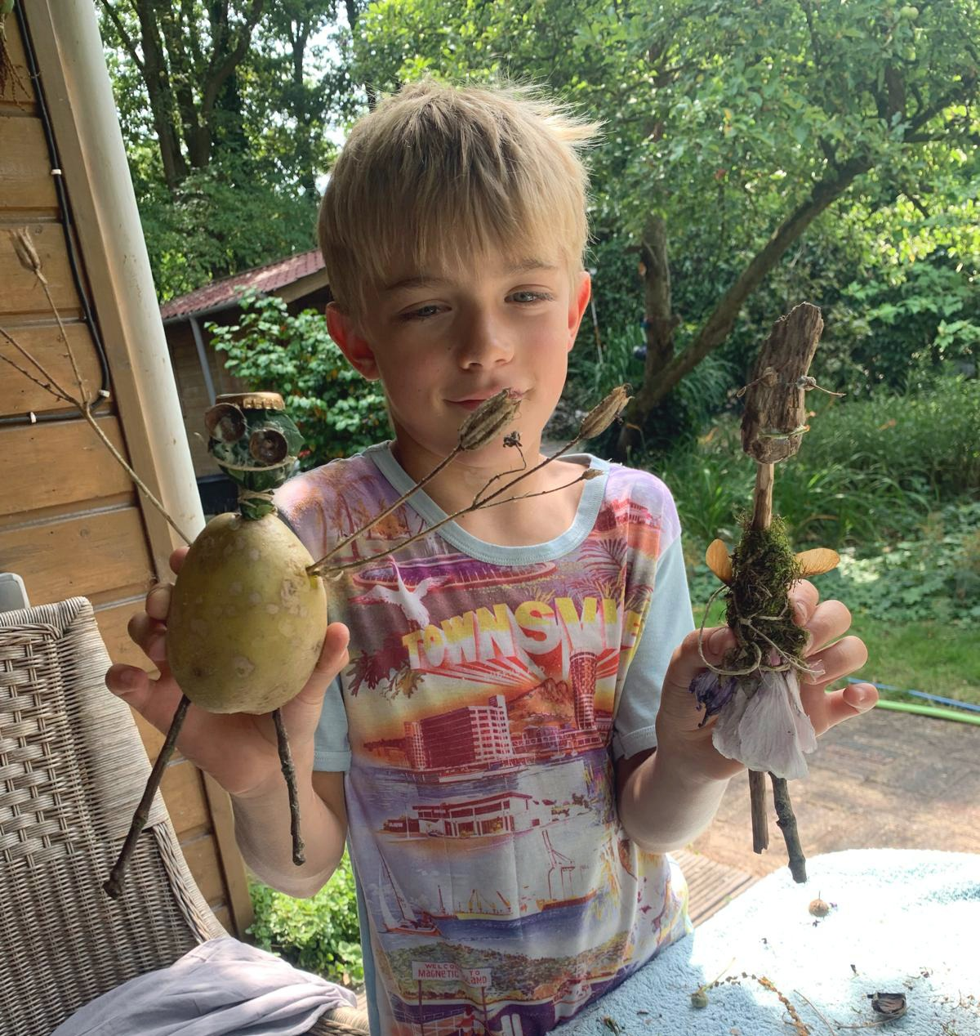
August

Slide 10
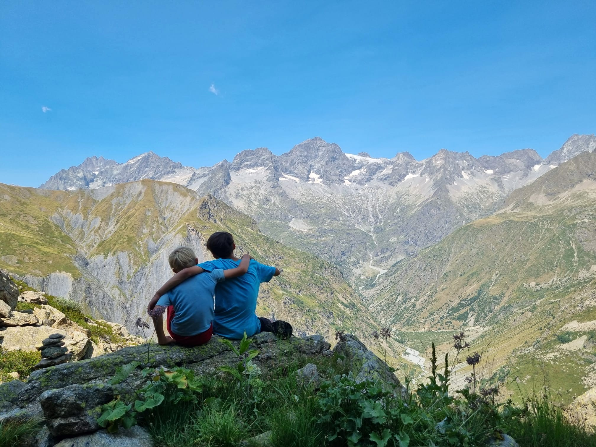
September
Notes:
In the French Alps

Slide 11
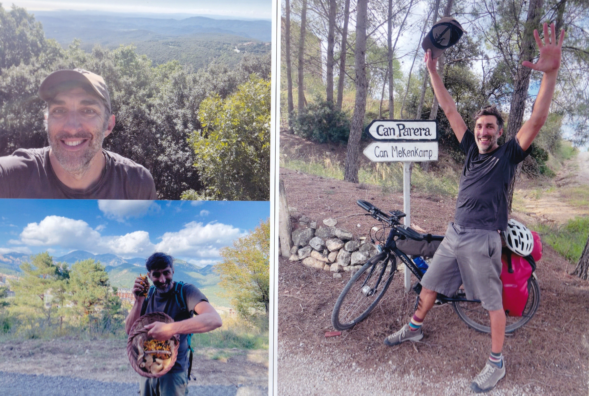
October
Notes:
Jim’s solo ride from Lyon to Barcelona

Slide 12
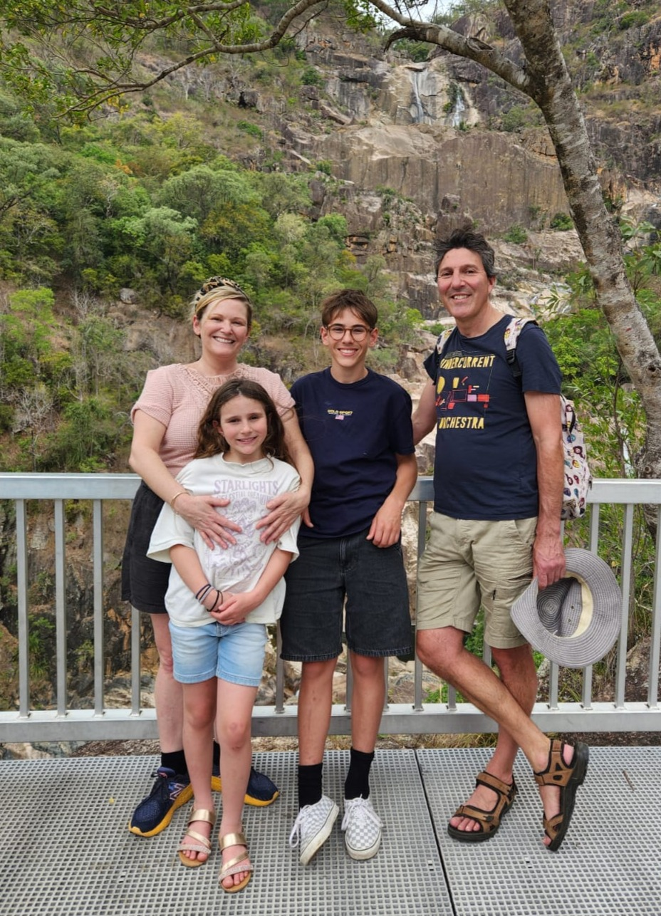
November
Notes:
In the Atherton Tablelands, Nth Queensland

Slide 13
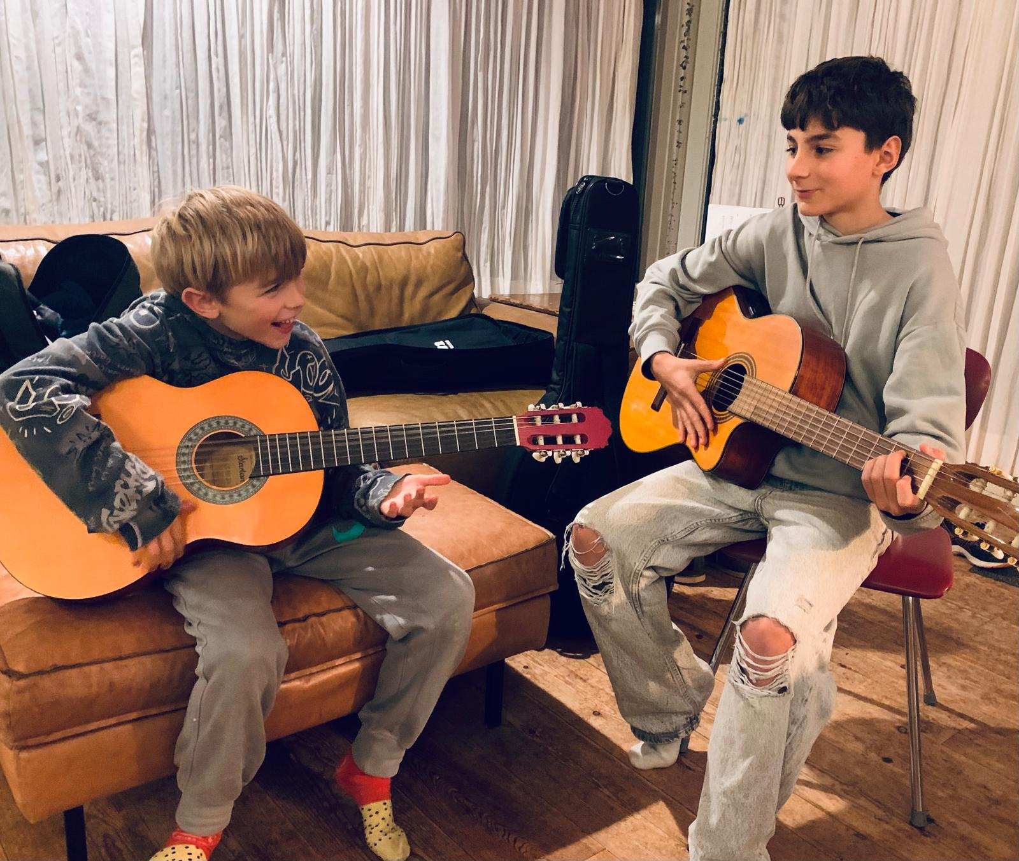
December
Notes:
Dat wordt vast wat!

